Slide 1


Slide 2
State of the QA and UI

Slide 3
Acceptance Tests
Created Master Page
Created User Information Table
Created Landing Page (Index)
Created Sign-Up page

Slide 4
Acceptance Tests
Created message Framework
Created encryption Framework
Created search Feature
Created message Dashboard

Slide 5
Acceptance Tests
Created One-on-one communication.
Notify user about the new messages
Created admin dashboard

Slide 6
Acceptance Tests

Slide 7

State of the Code
Style Conventions
Oracle
C#
Asp.net

Slide 8
User interface
Bootstrap: Primary framework
Total number of Pages : 5
Primary Color: (#1E90FF) Dodger Blue

Slide 9
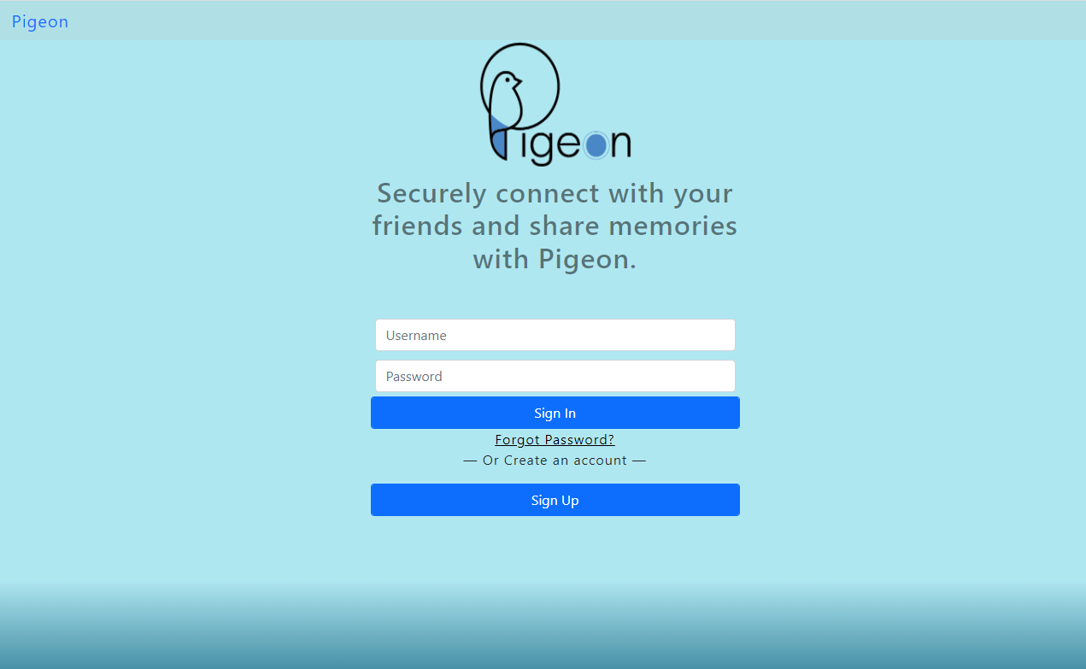
Index / Log-In

Slide 10
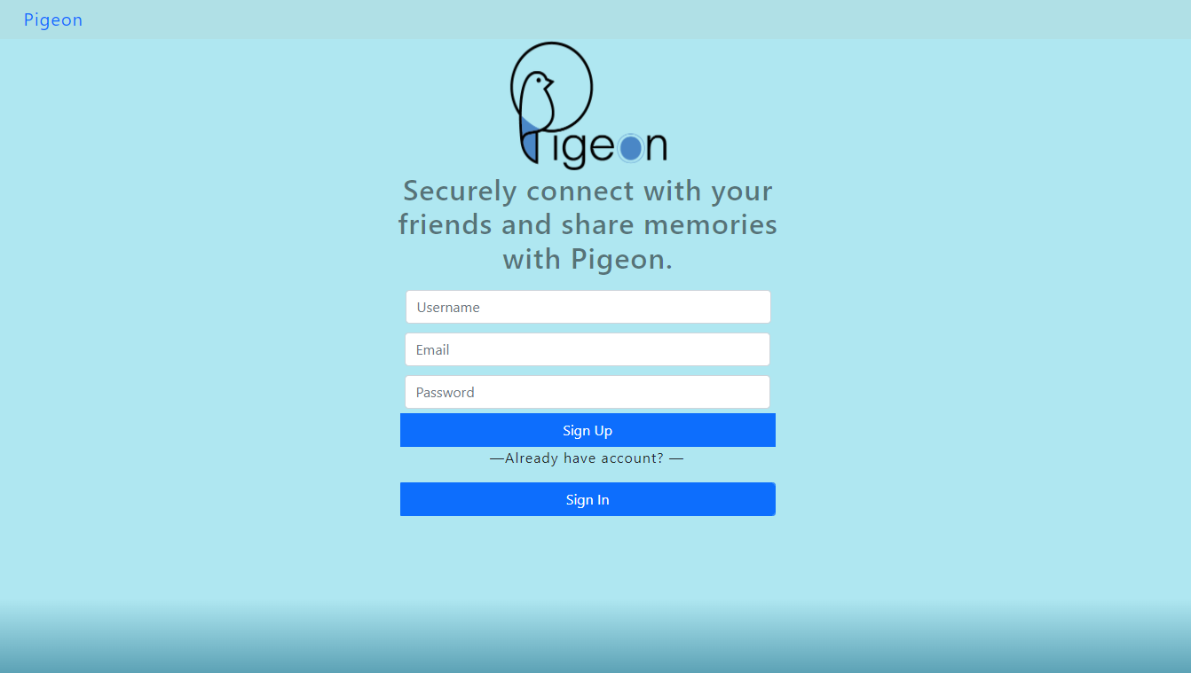
Sign up

Slide 11
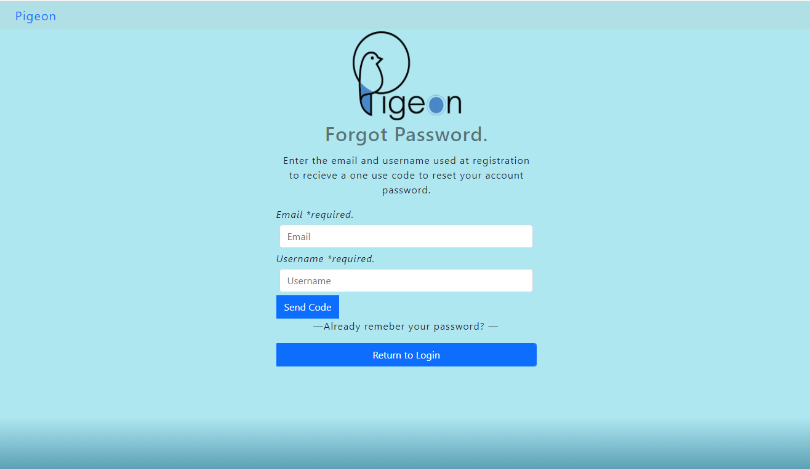
Forgot Password

Slide 12
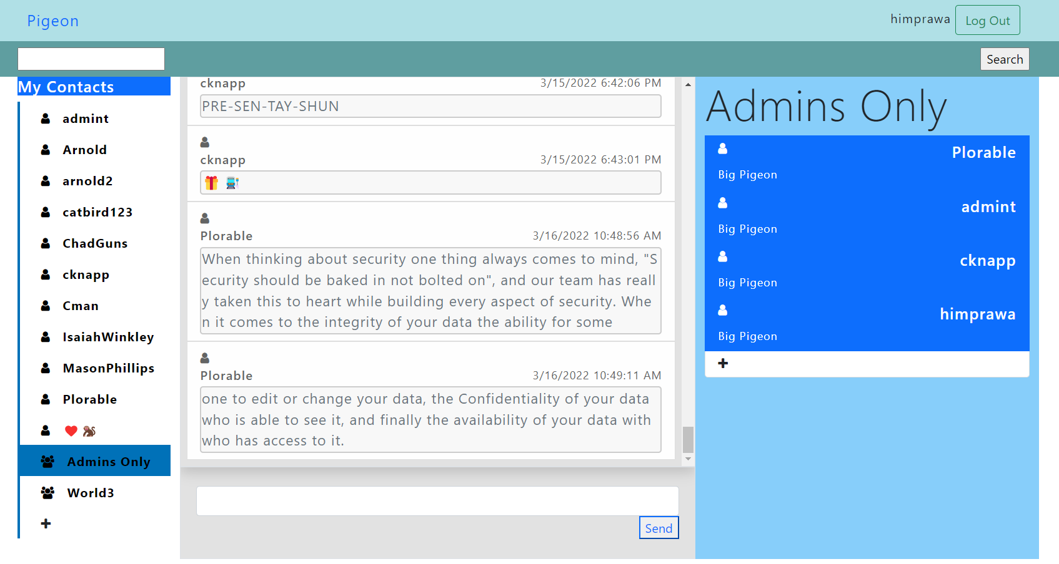
Nest

Slide 13
State of the Database

Slide 14

Design and Implementation
Entity Relationship Model
ERD or Entity Relationship Diagram
Oracle PL / SQL

Slide 15
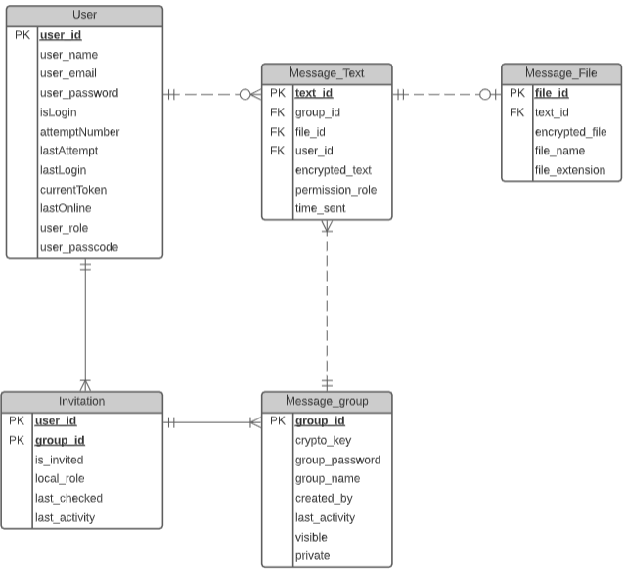
Entity Relationship Model
User
Can send a text or a file
Must be in a group to communicate, one-to-one or otherwise
Message Text / File
Must be sent to a group
Message Group
Can be created for private chats or group chats

Slide 16
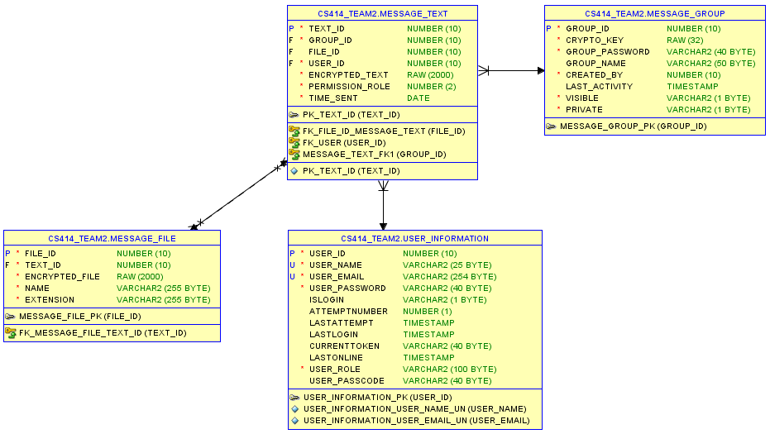

Slide 17

Oracle PL/SQL
Packages
Functions and Procedures
Security
Add a user
Log in and Log out
Messaging
Send message
Get all group messages
Nests
Create group nest
Create private nest

Slide 18
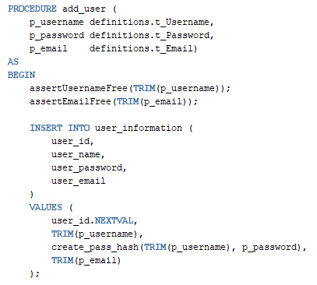
Security Package
User creation
Username – trims white spaces
Varchar2, unique, not null
Email – uses regex for format
Varchar2, unique, not null
Password – stored as hash
Varchar2, not null

Slide 19
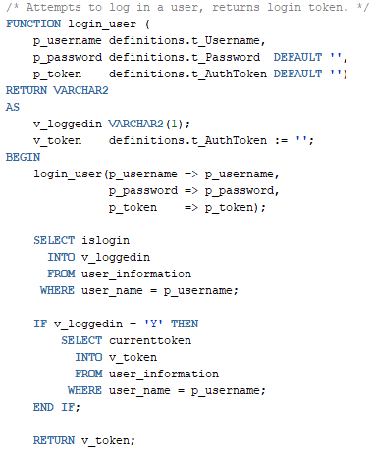
Security Package
Login input information
Username and password
Login output information
Login token (for authentication)

Slide 20
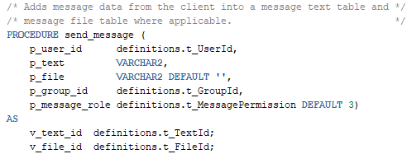
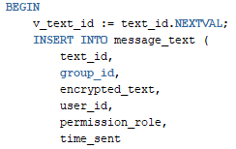
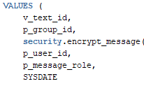
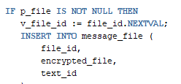

Messaging Package
Sending a message
The file attached is defaulted to null
Checks if a file is included
Values:
Stores encrypted texts and files

Slide 21

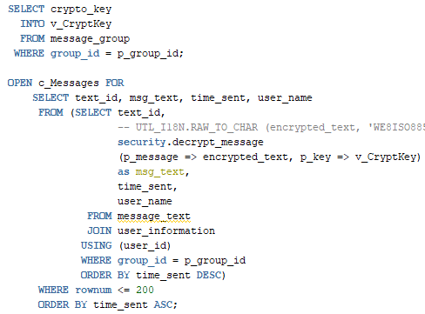
Messaging Package
Viewing messages
Checks if a user is invited to the group
Gets the messages from the message text table and shows the latest set of messages

Slide 22
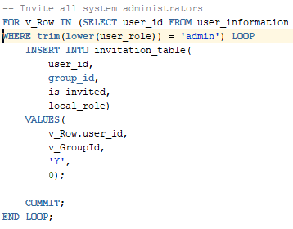
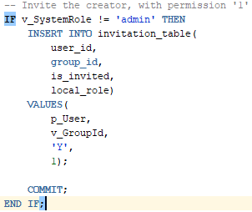
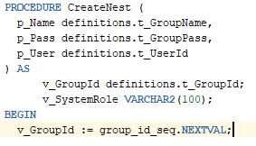
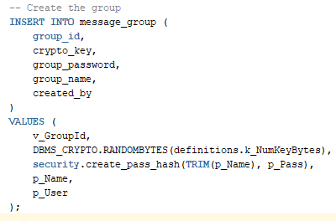
Nests Package
Creating a group nest
For each group, admins are automatically added
The user who created the group will have their role set to ‘1’

Slide 23
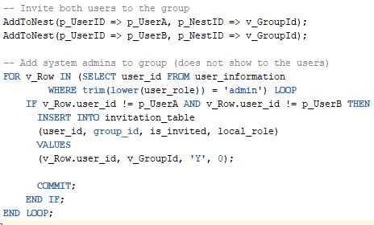
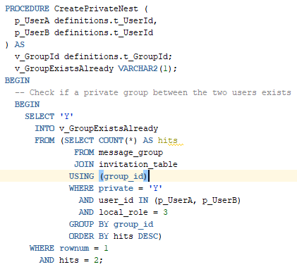
Nests Package
Creating a private nest
Checks if a private nest already exists between userA and userB
Admins are still included into the invitation even in a private nest
Roles for every user in a private nest is set to ‘3’ (default)

Slide 24
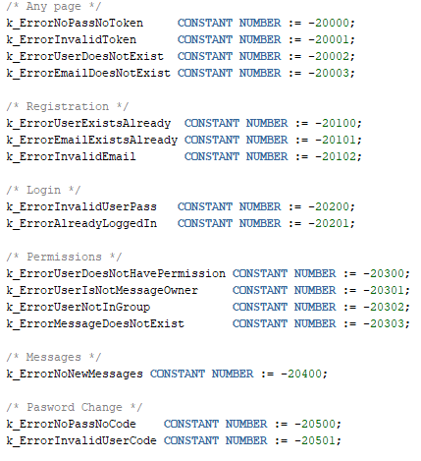
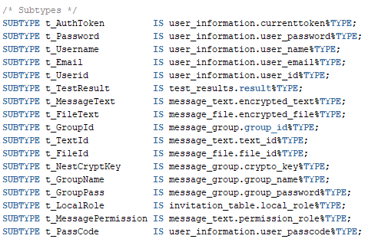
Definitions Package
Standardized error checking
Constants
Regex (email)
Subtypes

Slide 25
State of Security
Notes:
State of Security
Pigeon
When thinking about security one thing always comes to mind. “Security must be baked in and not bolted on.” Our team has really taken that into consideration each step of the project and thought about security as we built instead of as an afterthought. The next thoughts we have are toward Integrity the ability for others to modify your data. Confidentiality the ability for others to view your data that hasn’t been explicitly shared with them. Finally, to close these to off and the biggest player for us is availability, which is the biggest focus for us as a team. The availability of data or denial of access is really where we cover all these pieces. Since we will be calling functions to retrieve data from a database full of user information there are several steps, we have taken to secure this data, and verify that only the users that should have access to this data have access.

Slide 26
User Information Security
Database Assertion Functions
Verify who the user is, and this users ID is what is used to verify all data access.
Unique Usernames and User IDs
Because so much about the user is unique it makes securing user data simple.
Messages
Assertions for User Role, Permissions, Group Access
Symmetric Message Encryption
AES 256 bit with Padding
DBMS_CRYPTO
To change an aspect of the message we assert that the user is the owner (“removing messages”)
Notes:
User Information Security
Identification, Authentication, Authorization
Database Assertion Functions:
To gain access to any user data you must be logged in as a user on the site. This is done through a login portal. The user that you logged in as is what is used to verify any further access to data. We use the user’s ID, which is unique to each user, to check whether they have access to data from group chats of users, messages, and other types of user stored data that should be accessed.
Messages:
First, we verify that the user asking for access has permission to view a message, and that they are in the group with the message. Because of this if a user is not in a group, they would access to no messages until they were added to a group. We also assert that a user is the owner of a message, and this assertion will be used with setting message permissions and removing the message. Messages are stored using symmetric AES 256-bit encryption. And only decrypted from a database call using all the previous mentioned verifications to check that the user is in the group and has access within the group.
Symmetric Encryption:
The encryption key is different for every group and is not shared to the web application at any point.

Slide 27
Login Security
Password Security
Passwords will have required length of 8.
Login Attempts
Max login attempts will be set to 5 to prevent brute attacks.
Password Recovery
User can reset their password using a code that will expire 24 hours after is set or immediately upon their next successful login.
Padding and Username
Passwords are stored in hashes and compared to allow the password to be hidden from view and never stored in plain text.
Notes:
Login Security Expanded
Password Security:
User passwords are never stored in plane text. When registering or changing a password the user password is sent to the database and hashed using 128-bit padding, their username and password. This hash, which cannot be reversed, is used to compare every-time the user logs in to the website. The user’s password has a required length of 8 characters. No other requirements are currently in place, so users have complete control of their password’s security and convenience.
Login Attempts:
In order to prevent a brute force, attack we have set a maximum login attempt amount of 5. After reaching his amount the user’s login attempts will be temporarily suspended.
Password Recovery:
If the user has forgotten their password, we allow a 2-factor password reset using the user’s username, and a code sent to their email. This code is reset after 24-hours or immediately upon their next login.

Slide 28
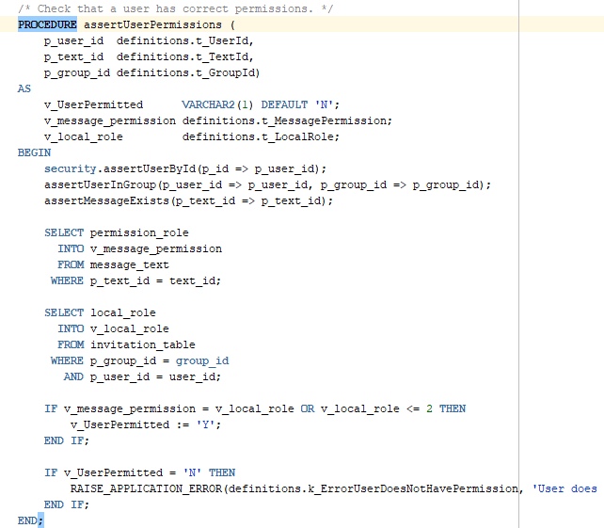
Database Security
Database password changed every 30 days
Assertion Functions
Validation
Unique
Unique Identifiers
DBMS_CRYPTO
Hashing
AES 256-bit Encryption
Notes:
Database Security Expanded
Database Security:
Database Password is changed every 30 days.
Assertion Functions:
We use assertion functions when sending data and receiving data from the database. We have procedures on account creatin to verify that a username and email are unique. Other procedures verify that a user is allowed to access certain data.
DBMS_CRYPTO:

Slide 29
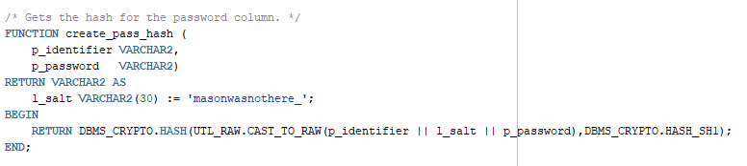
DBMS_CRYPTO Password Hashing
Notes:
Hashing:
Our hashing function uses DBMS_CRYPTO. Hash() which takes in the raw data, and the hashing type and returns the hash we compare all user passwords to that is stored in database.

Slide 30
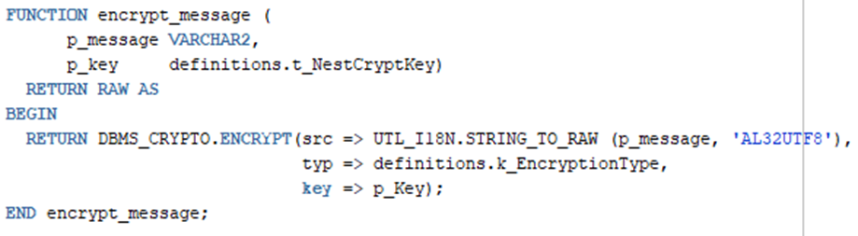
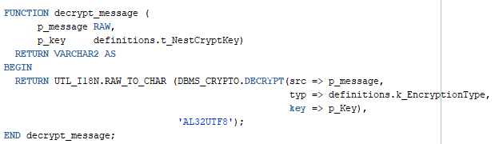
DBMS_CRYPTO Encrypt/Decrypt
Notes:
Encrypt:
Our encrypt function uses DBMS_CRYPTO.Encrypt() which takes in the raw data converted from the message (which has a Unicode standard declared with it), the type of encryption we are using AES 256-bit, and the encryption key associated with the group that contains the message.
Decrypt:
Our decrypt using DBMS_CRYPTO.Decrypt() takes in the same parameters minus the Unicode which is applied after the raw data is decrypted, and we would be taking in the raw encrypted text.

Slide 31
C# and ASP Security
Use of Data Bind Variables to Take Only What We are Looking for When Sending Code to the Database.
PL/SQL Anonymous Block
Obfuscated Password Text Box
Message Boxes Will be Locked until Clicked
Notes:
C# and ASP.NET Security
Front End Security:
Use of Data Bind Variables to Take Only What We are Looking for When Sending Code to the Database.
PL/SQL Anonymous Block
Obfuscated Password Text Box

Slide 32
What needs to be completed?

Slide 33
Group creation
Nests
User created
Custom names
Roles
Nest Creator
Administrators
Custom Roles
Invite only
Developers
Mason Phillips
Timothy de Jesus
Time Needed
12 hours

Slide 34
Image and file sharing
File types
.doc, .docx, .pdf, .txt
.png, .jpg, .jpeg
Storage
Converted to Base64
Encrypted in database
Text Documents
Images
Developers
Timothy de Jesus
Time Needed
16 hours
Himprawa Khattri

Slide 35
Shoulder surfing protection
Messages
Ciphertext
Click to decrypt
Permission-based
Developers
Mason Phillips
Time Needed
20 hours
Caleb Knapp

Slide 36
State of the Team

Slide 37
What have we done well?
Teamwork
Codebase Design

Slide 38
Teamwork
Most of our development time was spent together, working as a group.
Implemented pair programming to balance the workload and evenly spread knowledge of the codebase.

Slide 39

Codebase Design
Object-Oriented Design
Database Packages
Website Utility Classes

Slide 40
What have we not done well?
Lack of formal meetings
Communication through software tools

Slide 41
Lack of formal meetings
Response Plan
Written meeting procedures
Weekly Individual Role Meetings
Weekly Team Meeting

Slide 42
Communication through software tools
Response Plan
Microsoft Teams
Microsoft Planner
Meeting documentation shared
More questions and confirmations
Task status reminders
Daily reviews

